Slide 1
Domestic Migration Patterns
Analyzing trends in metropolitan areas to Identify successful Metropolitans

Slide 2
Team Members
Swathi Toyaja Chepyala
Myra D’Souza
Snigdha Cheekoty
Meghana Tunga
William Nguyen

Slide 3
Problem Definition
The metropolitan revolution is being defined by high-skilled workers in technology and science fields ready to move to different areas for better job opportunities and to be part of an innovative and inclusive economy.
High-skilled migrant workers create job opportunities, boost the economy and lead innovation.
Could we identify the next metropolitan area that will experience an influx of migrants, attract more businesses and metros that will have a stable economy?
Notes:
Inclusive economies head innovation with a healthy entrepreneurial presence of younger companies and more established companies

Slide 4
Problem Space
We study different factors from many researchers like David Autor, Economist at MIT and Bruce Katz, Vice President of The Brookings Institute.
We will build a model using various machine learning techniques to understand the importance of various attributes that make a metropolitan successful. We will compares our results to pick the best performing algorithm
Notes:
Link to explain work of David Autor and Bruce Katz
https://economics.mit.edu/files/11563
http://wesa.fm/post/age-political-gridlock-new-book-says-look-local-leaders#stream/0

Slide 5






Project Roadmap
Problem Definition
Datasets
Analysis/Algorithm
Visualizations
Final Insights
Sprint 1
Sprint 2
Sprint 3
Sprint 4
Sprint 5
Week 1 week 2 week 3 week 4 week 5 week 6 week 7 week 8 week 9 week 10 week 11

Slide 6















Data Pipeline
Validate
Model
Data
Explore
Feature Extraction
Pre Processed
Clean
Wrangle
Insight
Notes:
--We collected data from a wide range of sources like .....
--This is mainly because we wanted to make sure that we incorporated all the factors that might directly contribute to the migration of people.
-- collected around 50 -60 datasets having different factors.
-- combing the data was a BIG CHALLENGE. because data wasn't homogeneous.
-- after that , we cleaned the data and imputed missing values.
-- Correlations have been found and feature selection has been done using PCA. 370---170

Slide 7
Datasets Combined
Employment data - Bureau of Labor Statistics
- Employment across industries, unemployment rates
- Laborforce, population able to work (2001- 2016)
- Unemployment rate(%), unemployed individuals from laborforce (2000- 2016)
Migration, Population data – Census Bureau American Community Survey
- Population estimate change done from year 2010 data
- International, domestic and net migration from (2010-2016)

Slide 8
GDP rate – Bureau of Economic Analysis
- Gross domestic product for the metropolitan (2002-2016)
Violent crime – Federal Bureau of Investigation
- Rate of violent crimes per 100,000 residents (2001-2016)
University data – US News
- Best Universities in the US within 30 miles of a metro (2016)
Home Price Index – Federal Housing Finance Agency
- Timely, accurate indicator of house price trends
- Estimating changes in the rates of mortgage defaults, prepayments and housing affordability (2005-2017)

Slide 9
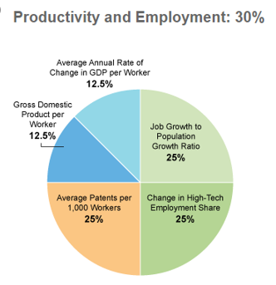
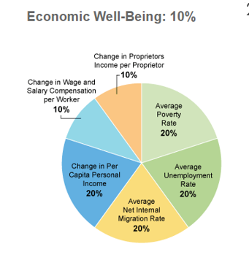
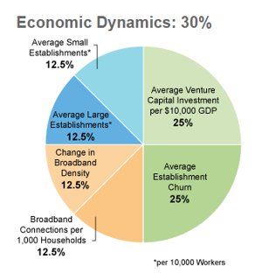
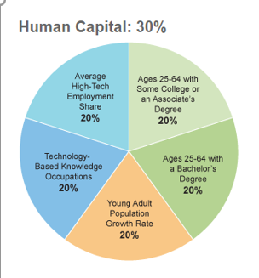
Innovation Index
StatsAmerica Inovation 2.0
- Measure for capacity of innovation and innovative output of a region
Source: https://www.statsamerica.org/innovation/reports/sections2/C.pdf
Notes:
Human Capital and Knowledge - region’s population and labor force are able to engage in innovative activities
Economic Dynamic - gauges the competitiveness of a region by measuring the entry and exiting firms in that region. Also measures local business conditions and resources available to entrepreneurs and businesses.
Employment Productivity - economic growth, regional desirability or direct outcomes of innovative activity
Economic Well Being – measures standard of living, wages and unemployment rate and migration

Slide 10
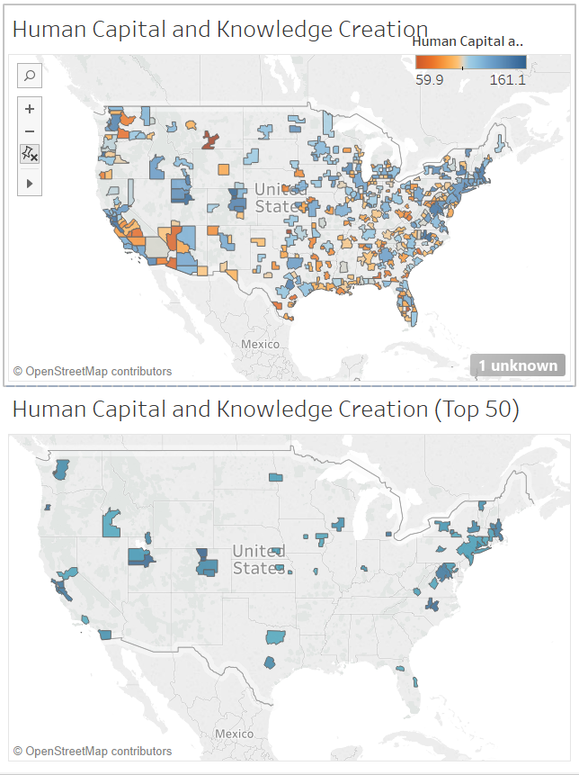
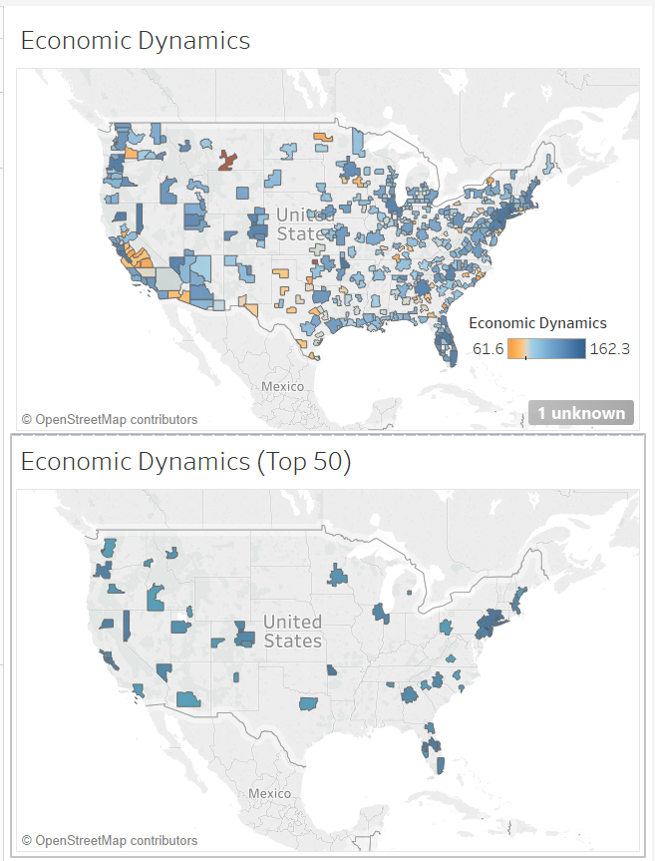
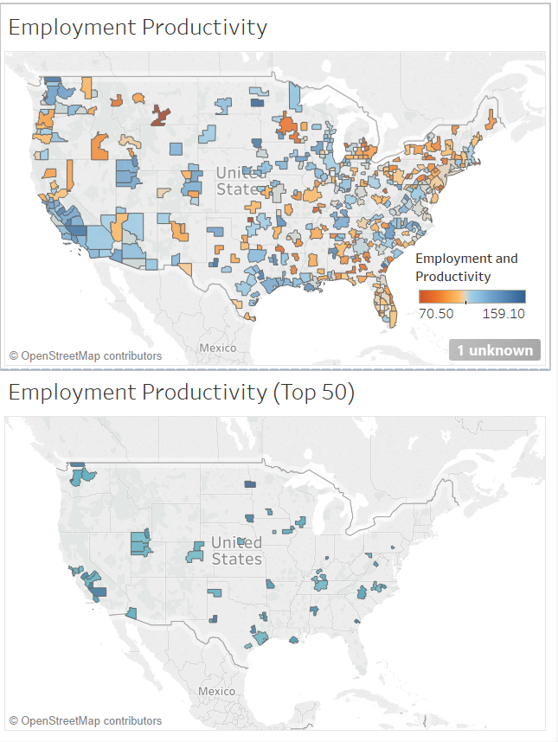
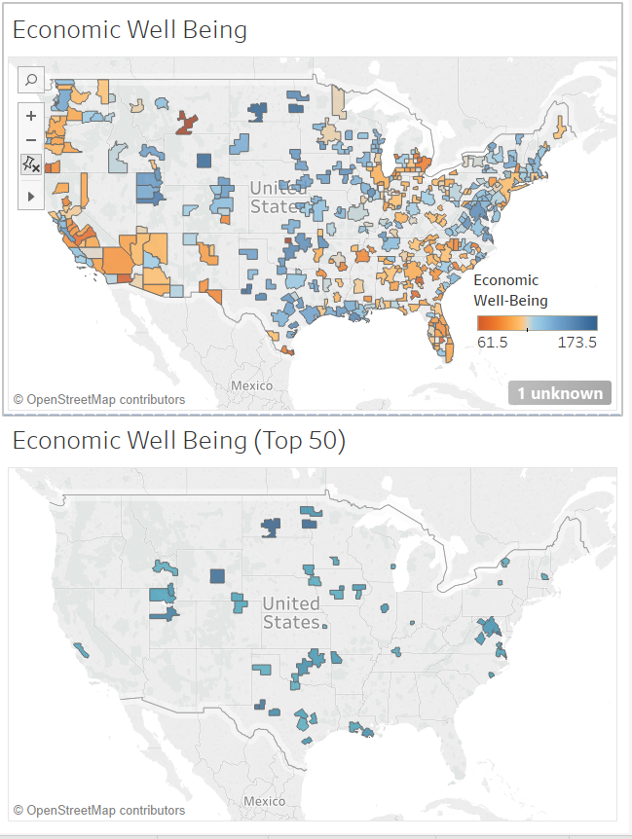
Innovation Index Spatio-Temporal Analysis
Human Capital and Knowledge
Employment Productivity
Economic Dynamic
Economic Well Being
Notes:
Human Capital and Knowledge - region’s population and labor force are able to engage in innovative activities
Economic Dynamic - gauges the competitiveness of a region by measuring the entry and exiting firms in that region. Also measures local business conditions and resources available to entrepreneurs and businesses.
Employment Productivity - economic growth, regional desirability or direct outcomes of innovative activity
Economic Well Being – measures standard of living, wages and unemployment rate and migration

Slide 11
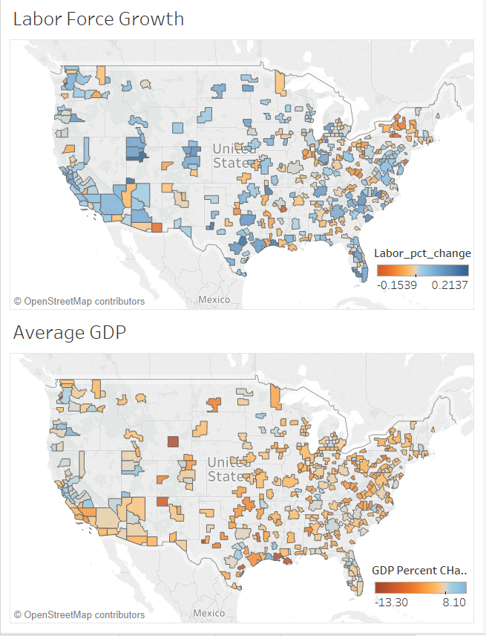
Labor and GDP Data 2010-2016
Since 2010, Labor Force Participation Rate has grown 1.5% in metropolitans. Provo Utem, UT has the fastest growing labor force of 21%.
Other cities include Austin, TX, St George, UT, Lake Charles, LA
In 2016, National GDP rate was at 1.6%. Most MSAs were below the national average. Lake Charles, LA and Redmond, OR GDP was 8.1%.

Slide 12
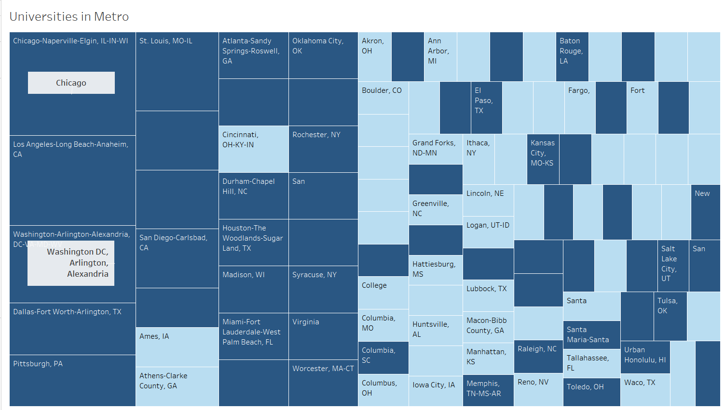
Ranked Universities in more successful metropolitans
Notes:
Metropolitans rated as successful are marked in dark blue. We found the highest ranked universities in the US were located within the geographical area of successful metros.

Slide 13
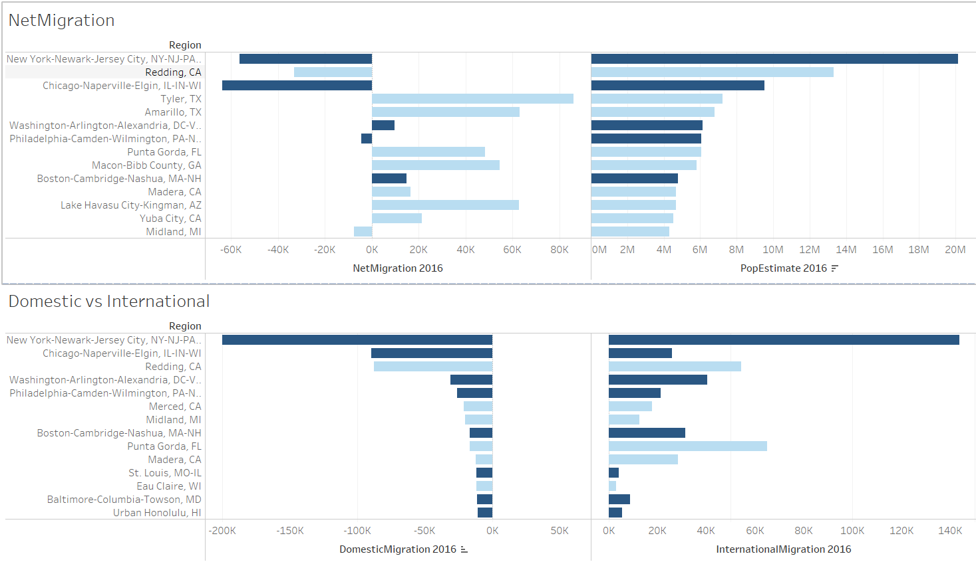
Census Bureau - Migration Analysis
Notes:
We looked at census bureau migration numbers. Successful metros are marked in dark blue. Areas like New York and Chicago had the highest estimated population growth. However, more international migrants were coming in and domestic migrants leaving th

Slide 14
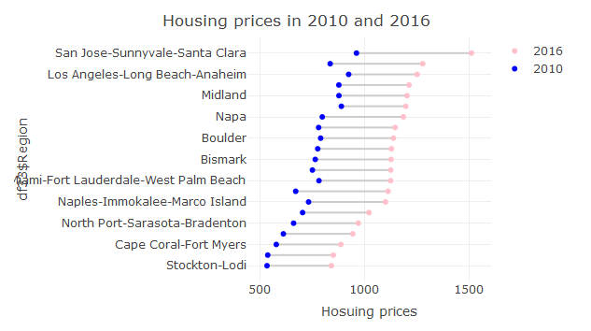
Housing Price Index

Slide 15
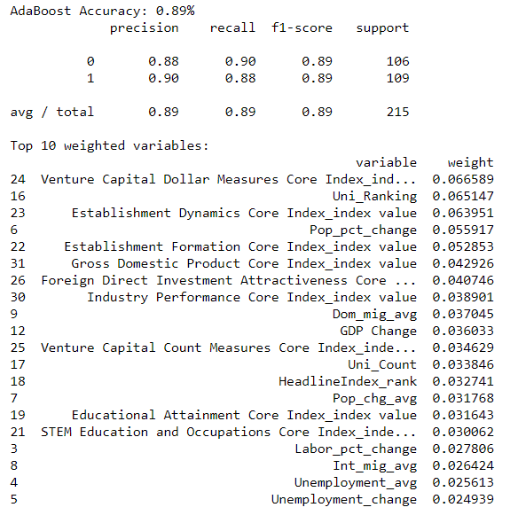
Feature Importance/Model selection
 | precision | recall | accuracy
Logistic Regression | 82 | 82 | 82
SVM | 91 | 88 | 88
Random Forest | 86 | 86 | 86
Decision Tree | 85 | 85 | 85
MLP | 74 | 73 | 73
Adaboost | 89 | 89 | 89

Slide 16
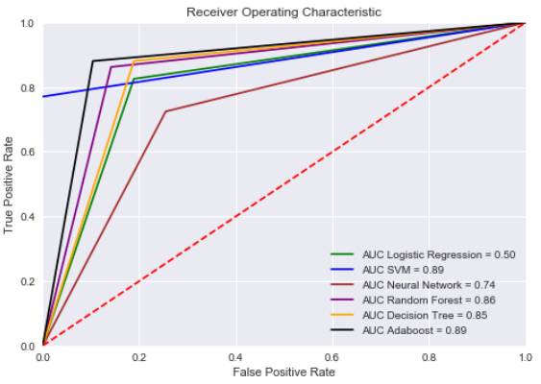
Evaluation
Adaboost model. We use random forests as a weak learner of AdaBoost for selecting the high weight instances during the boosting process to improve accuracy, stability and to reduce overfitting problems
Notes:
Balancing variance and bias. https://en.wikipedia.org/wiki/Receiver_operating_characteristic
https://towardsdatascience.com/the-random-forest-algorithm-d457d499ffcd
https://en.wikipedia.org/wiki/AdaBoost

Slide 17
Next Best Metropolitans

Slide 18
Looking Forward/Future Work
Collect more data specific to metropolitan areas
Most government agencies are not yet reporting data by metropolitan regions
Add more external data sources like job opening data by industry. Currently JOLTS does not report for metropolitan regions.
Innovation index2.0 will be adding a 7th category for state context. This would include measures like education funding per pupil, Institutionally-Based Startups.
Further analysis on features, more feature engineering and feature importance study
Ranking regions in order of most likely to see growth
Notes:
This data could be used for finding the next big metropolitan areas that would have more job opportunities.
we could also include few housing and neighborhood factors like Walk score and transit score for different zipcodes within the metropolitan areas.
This would help us to know which are the best areas preferred for housing by the people.

Slide 19
BACKUP SLIDES

Slide 20
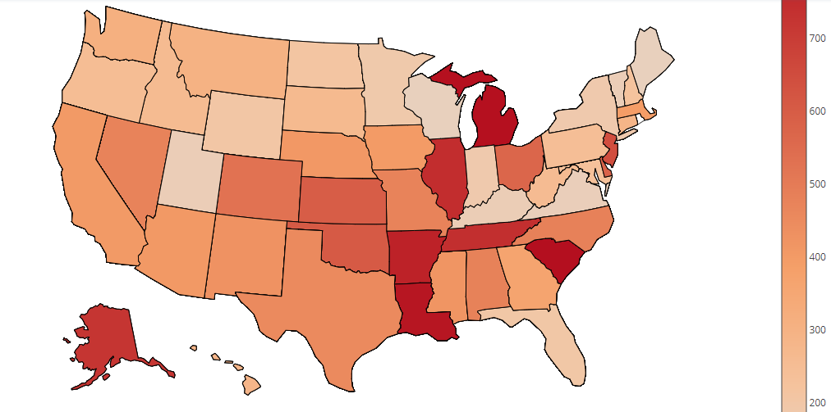
https://plot.ly/~mtunga/9/
https://plot.ly/~mtunga/15.embed
Average crime rate

Slide 21
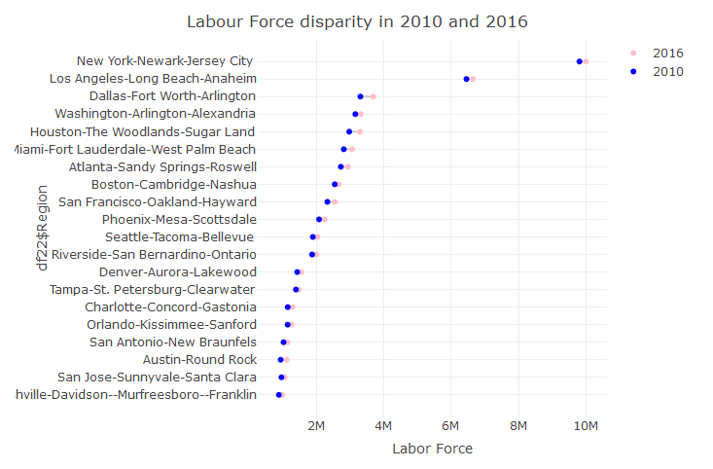
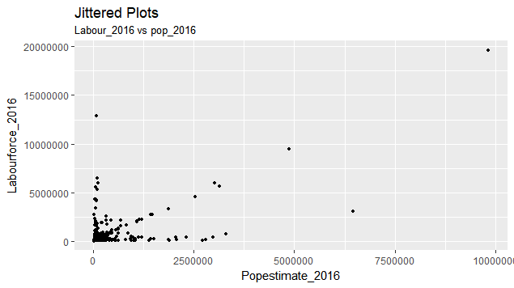

Slide 22
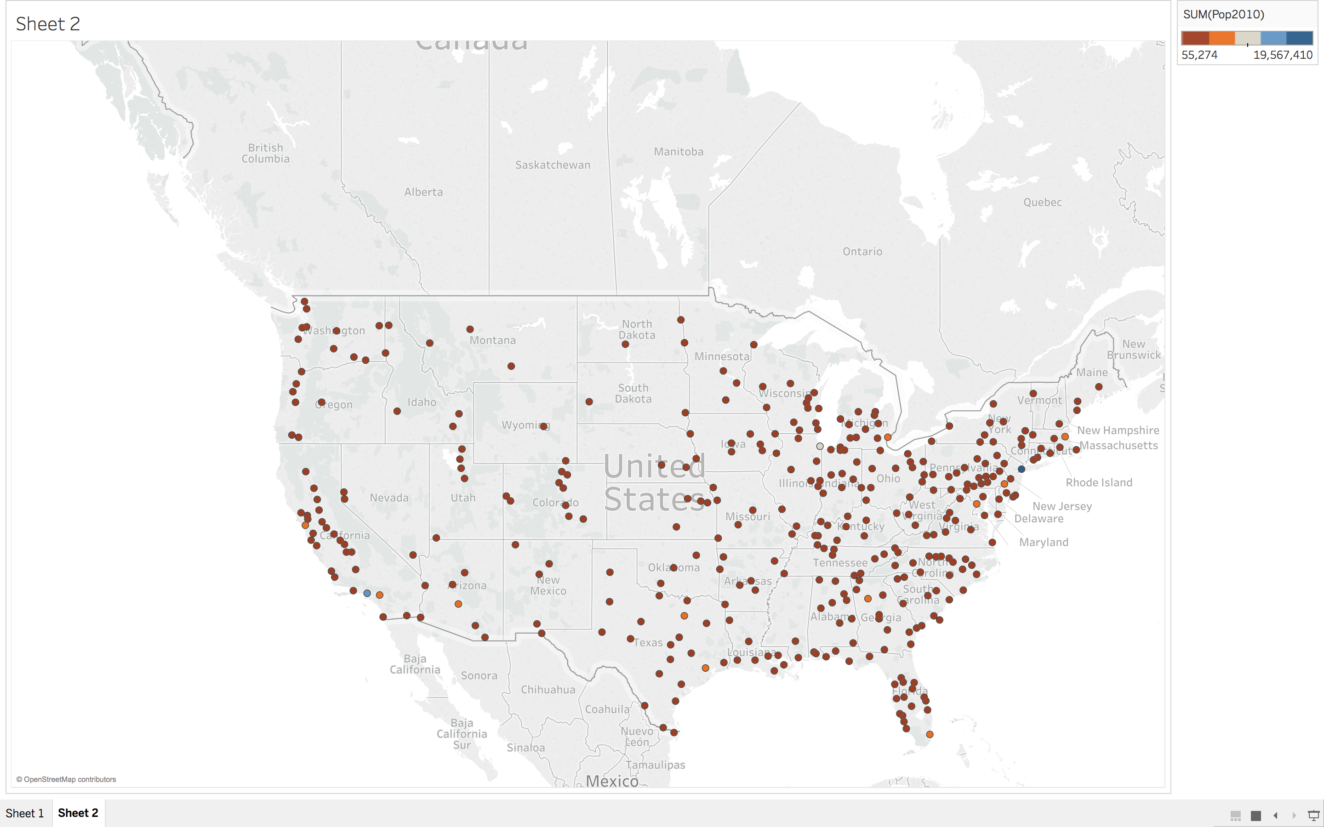
Population Estimate for 2010

